Slide 1
Interpretability of transformer models

Slide 2
Why interpretability?
Black box notion of models
Help builds transparency and trust of the model’s prediction

Slide 3
Why NLP/transformer models?
Less interpretability tools for NLP compared to NN or CNN
Transformer models are fairly recent (BERT released on May 2019)

Slide 4
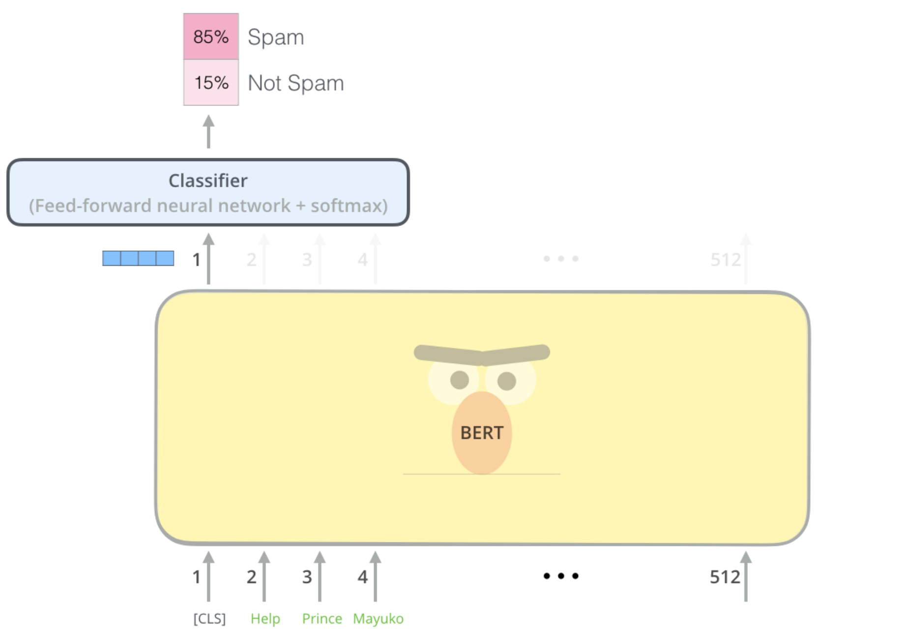
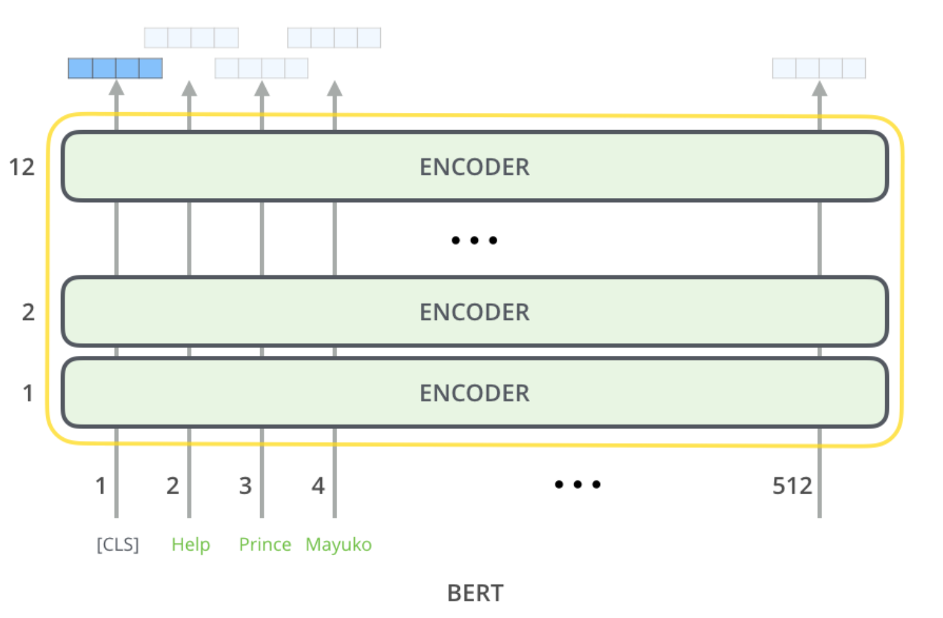
What is a transformer model?
Series of encoders stacked on top of each other
With the output layer modified according to our task

Slide 5
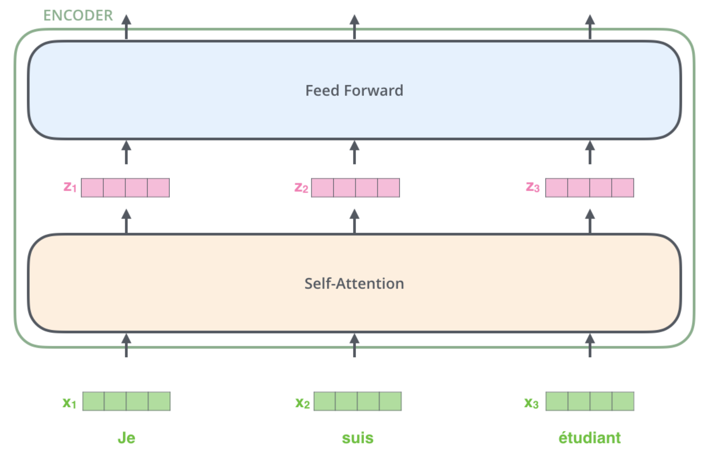
What is an Encoder?
Comprised of an Attention Layer and a Feed Forward Layer
Attention Layer - As the model processes each word (each position in the input sequence), self attention allows it to look at other positions in the input sequence for clues that can help lead to a better encoding for the word
Feed Forward Layer – Stacks of Encoding RNNs

Slide 6
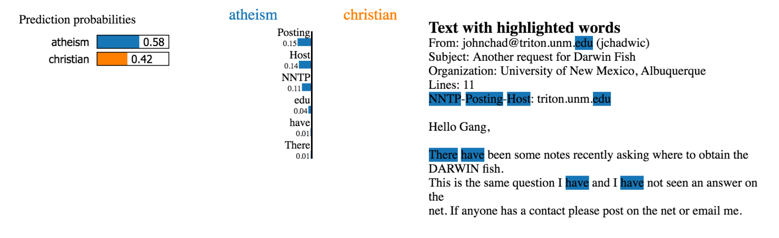
Tools of interpretability - LIME (Local Interpretable Model-Agnostic Explanations)

Slide 7
The Approach
Use pre train model to predict on a few multiclass dataset and use Lime to see how the transformer model predicts

Slide 8
Work done and work that needs to be done
Applied three pre-trained model on a few multi class dataset
Analyzed the results
Need to fine tune the model
Integrate with Lime
Pipeline the process

